Slide 1
Implementing Visualisations of Conway’s Game of Life
L3 CS Project, Durham University
Robbie Jakob-Whitworth

Slide 2
Definition
Research Question
Deliverables
Progress so far
Analysis and evaluation
Conclusion

Slide 3
Definition
Research Question
Deliverables
Progress so far
Analysis and evaluation
Conclusion

Slide 4
Conway’s Game of Life is a zero-player game.

Slide 5

Initial state determines evolution of the game.
Alive
Dead
Notes:
Highlight the colours used to describe alive and dead cells throughout this presentation.
Point out how cells have neighbours, including diagonals.

Slide 6
Cells have neighbours.
Alive
Dead
Neighbour
Notes:
Highlight the colours used to describe alive and dead cells throughout this presentation.
Point out how cells have neighbours, including diagonals.

Slide 7
Rules of the Game
Survival
2 or 3 live neighbours → cell survives
Death
0 or 1 or more than 3 live neighbours → cell dies
Birth
exactly 3 live neighbours → cell is (re)born

Slide 8
Consider a single live cell.
Alive
Dead
Notes:
Highlight the colours used to describe alive and dead cells throughout this presentation.
Point out how cells have neighbours, including diagonals.

Slide 9
Consider a single live cell.
Alive
0
Dead
Notes:
Highlight the colours used to describe alive and dead cells throughout this presentation.
Point out how cells have neighbours, including diagonals.

Slide 10
Consider a single live cell.
0
1
1
1
0
Alive
0
1
0
1
0
Dead
0
1
1
1
0
0
0
0
0
0
0
0
0
0
0
Notes:
Highlight the colours used to describe alive and dead cells throughout this presentation.
Point out how cells have neighbours, including diagonals.

Slide 11
Rules of the Game
Survival
2 or 3 live neighbours → cell survives
Death
0 or 1 or more than 3 live neighbours → cell dies
Birth
exactly 3 live neighbours → cell is (re)born

Slide 12
Consider a single live cell.
Alive
Dead
Notes:
Highlight the colours used to describe alive and dead cells throughout this presentation.
Point out how cells have neighbours, including diagonals.

Slide 13
Consider a line of live cells.
Alive
Dead
Notes:
Highlight the colours used to describe alive and dead cells throughout this presentation.
Point out how cells have neighbours, including diagonals.

Slide 14
Consider a line of live cells.
0
1
1
1
0
Alive
0
2
1
2
0
Dead
0
3
2
3
0
0
2
1
2
0
0
1
1
1
0
Notes:
Remind the listener that we count the neighbours of all cells, regardless of whether the cells are alive or dead.

Slide 15
Rules of the Game
Survival
2 or 3 live neighbours → cell survives
Death
0 or 1 or more than 3 live neighbours → cell dies
Birth
exactly 3 live neighbours → cell is (re)born

Slide 16
Consider a line of live cells.
Alive
Dead
Notes:
Highlight the colours used to describe alive and dead cells throughout this presentation.
Point out how cells have neighbours, including diagonals.

Slide 17
Consider a line of live cells.
Alive
Dead
Notes:
Highlight the colours used to describe alive and dead cells throughout this presentation.
Point out how cells have neighbours, including diagonals.

Slide 18
Definition
Research Question
Deliverables
Progress so far
Analysis and evaluation
Conclusion

Slide 19
Definition
Research Question
Deliverables
Progress so far
Analysis and evaluation
Conclusion

Slide 20
What is the most performant technique for visualising Conway’s Game of Life in a web browser?

Slide 21
“Most Performant”
How large can we make the grid before dropping frames?
CPU load
Memory usage
Average frame rate
Use profiler in browser

Slide 22
“Web Browser”
Implementation must work in a range of modern desktop web browsers, e.g.
Google Chrome
Firefox
Safari
Adhere to modern web standards.

Slide 23
Definition
Research Question
Deliverables
Progress so far
Analysis and evaluation
Conclusion

Slide 24
Definition
Research Question
Deliverables
Progress so far
Analysis and evaluation
Conclusion

Slide 25
Basic Deliverables
Compare different frontend implementation techniques:
Plain <div>s on the page + vanilla JavaScript
Plain <div>s on the page + React to only render the differences
HTML5 canvas

Slide 26
Intermediate Deliverables
Offload state computation to a server.
Compare different ways of sending the new state back to the client:
Sending the whole state versus just the changes
AJAX (long polling) versus WebSockets

Slide 27
Advanced Deliverables
Intelligently compute the state server-side.
Use hashing to avoid recomputing periodic or static regions.
(Outside the scope of this talk)

Slide 28
Definition
Research Question
Deliverables
Progress so far
Analysis and evaluation
Conclusion

Slide 29
Definition
Research Question
Deliverables
Progress so far
Analysis and evaluation
Conclusion

Slide 30
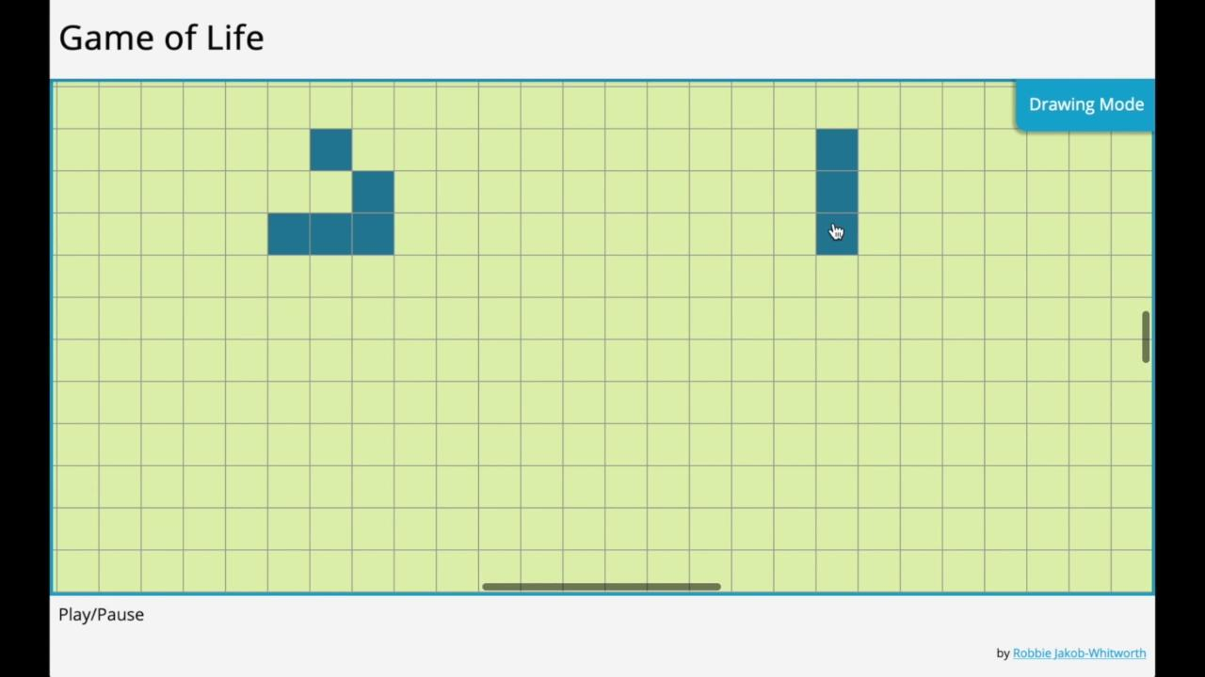
Progress so Far

Slide 31
<div>s and Vanilla JavaScript
Render Engine
Computation Engine
Interface
Interface Styles
Grid Styles
SASS Compiler
Webpack
Webpack
app.js
index.html
style.css

Slide 32
Definition
Research Question
Deliverables
Progress so far
Analysis and evaluation
Conclusion

Slide 33
Definition
Research Question
Deliverables
Progress so far
Analysis and evaluation
Conclusion

Slide 34
“Most Performant”
How large can we make the grid before dropping frames?
CPU load
Memory usage
Average frame rate
Use profiler in browser

Slide 35
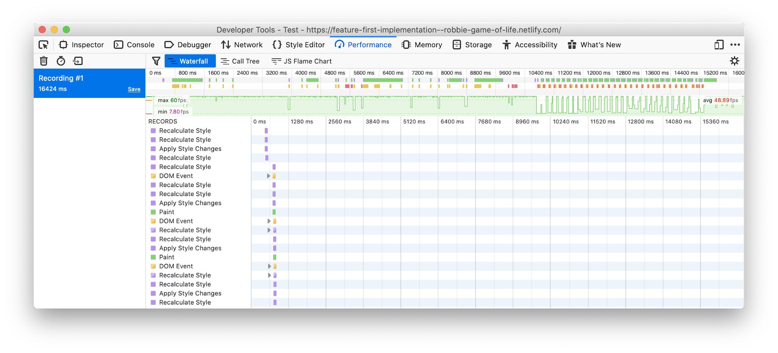
Browser Profiler
Recorded using Firefox 72.0.1

Slide 36
Browser Profiler
Minimum FPS: 7.80
Maximum FPS: 60
Average FPS: 48.89
Recorded using Firefox 72.0.1

Slide 37
Definition
Research Question
Deliverables
Progress so far
Analysis and evaluation
Conclusion

Slide 38
Definition
Research Question
Deliverables
Progress so far
Analysis and evaluation
Conclusion

Slide 39
Conway’s Game of Life is a zero-player game.
0
1
1
1
0
0
2
1
2
0
0
3
2
3
0
0
2
1
2
0
0
1
1
1
0

Slide 40
What is the most performant technique for visualising Conway’s Game of Life in a web browser?

Slide 41
Next Steps
Implement visualisations using other techniques
React, HTML5 canvas
Server-side state computation
Evaluate existing implementation

Slide 42
Implementing Visualisations of Conway’s Game of Life
L3 CS Project, Durham University
Robbie Jakob-Whitworth

